Slide 1
Git - Introduction
14-Sep-2018

Slide 2

Noticeable Challenges and Trends
AGENDA
01
Git Introduction
02
Git Commands
03
Git Examples
04
QA
04
08

Slide 3
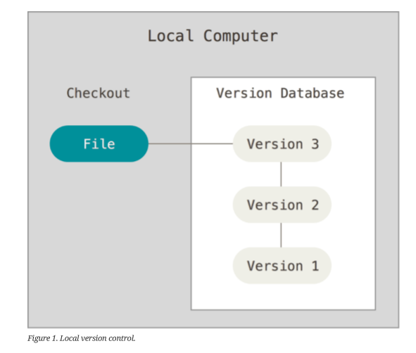
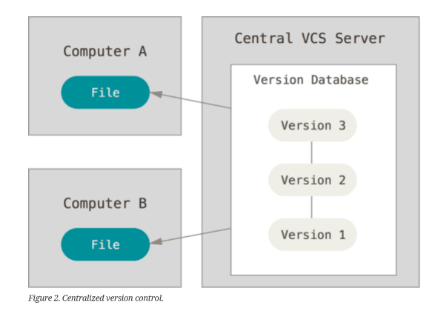
Local VS / CVS

Slide 4
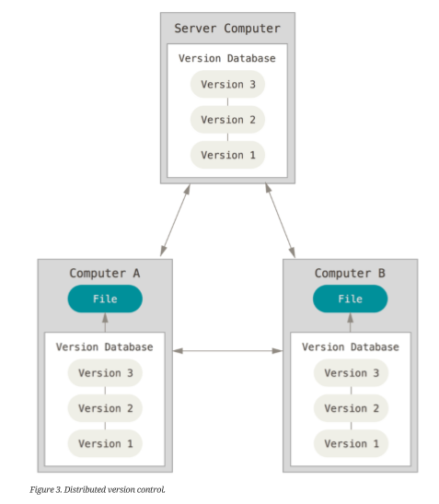
DVCS
In a DVCS (such as Git, Mercurial, Bazaar or Darcs),
clients don’t just check out the latest snapshot of the files; rather, they fully mirror the repository, including its full history.
If any server dies, and these systems were collaborating
via that server, any of the client repositories can be copied back up to the server to restore it.
Every clone is really a full backup of all the data.

Slide 5
A Short History of Git
In 2002, the Linux kernel project began using a proprietary DVCS called BitKeeper.
In 2005, the relationship between the community that developed the Linux kernel and the commercial company that developed BitKeeper broke down, and the tool’s free-of-charge status was revoked.
This prompted the Linux development community (and in particular Linus Torvalds, the creator of Linux) to develop their own tool based on some of the lessons they learned while using BitKeeper.
Some of the goals of the new system were as follows:
• Speed
• Simple design
• Strong support for non-linear development (thousands of parallel branches)
• Fully distributed
• Able to handle large projects like the Linux kernel efficiently (speed and data size)

Slide 6
Basic Git Workflow
The basic Git workflow :
1. You modify files in your working tree.
2. You selectively stage just those changes you want to be part of your next commit, which adds only those changes to the staging area.
3. You do a commit, which takes the files as they are in the staging area and stores that snapshot permanently to your Git directory.

Slide 7
Git Bash is a text-only cli for using Git on Windows which provides features to run automated scripts.
After installing Git in your Windows system, just open your folder/directory where you want to store all your project files; right click and select ‘Git Bash here’.
git config - - global user.name "<your name>"
git config - - global user.email "<your email>"
git config -- global user.email "senthil.alagarsamy@hcl.com"
git config -- global user.name "senthil"
git config --list

Slide 8
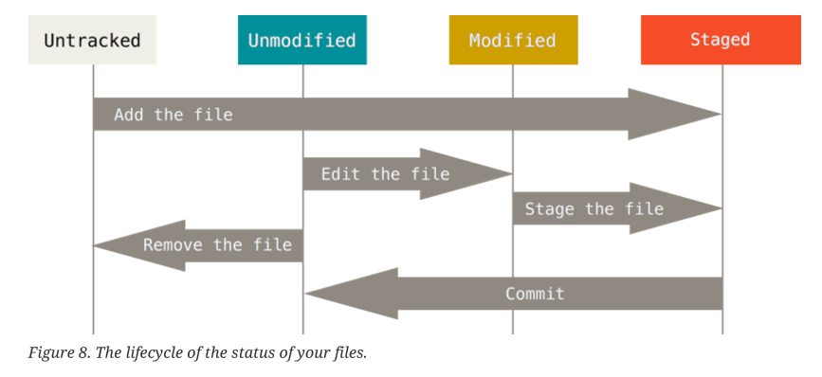
The lifecycle of the status of your files

Slide 9
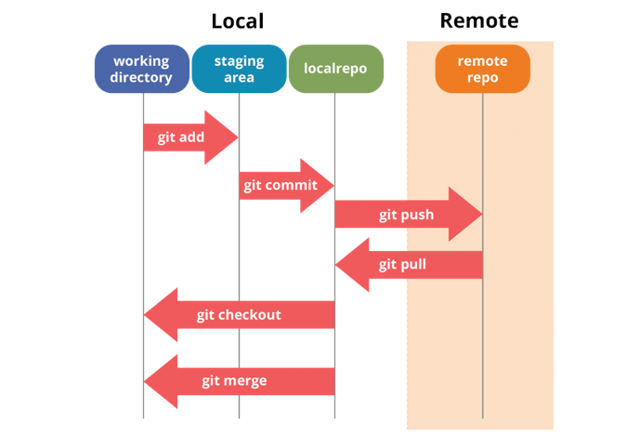

Slide 10
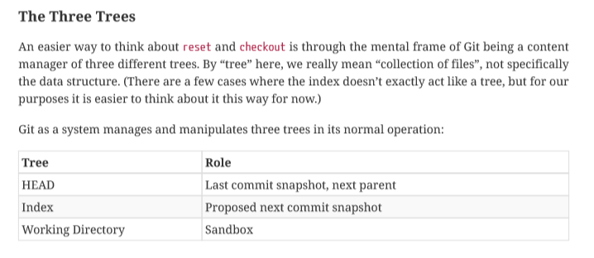
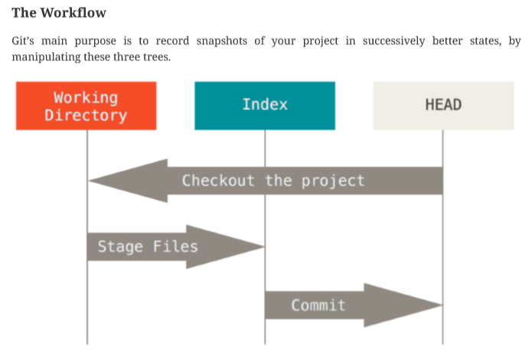
GIT WORKFLOW

Slide 11
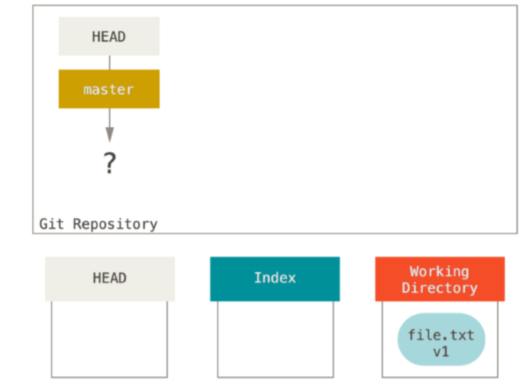
GIT WORKFLOW
Now we run git init, which will create a Git repository with a HEAD reference which points to an unborn branch (master doesn’t exist yet).

Slide 12
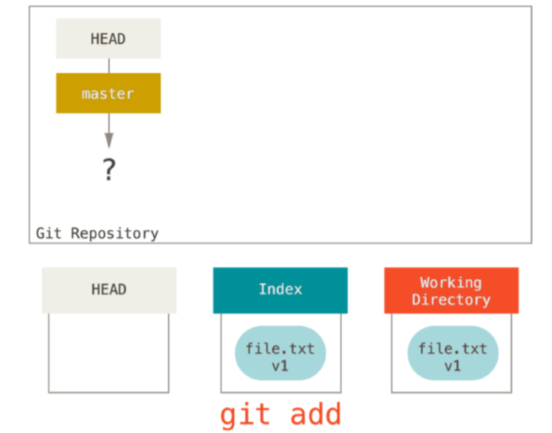
GIT WORKFLOW
Now we want to commit this file, so we use git add to take content in the Working Directory and copy it to the Index.

Slide 13
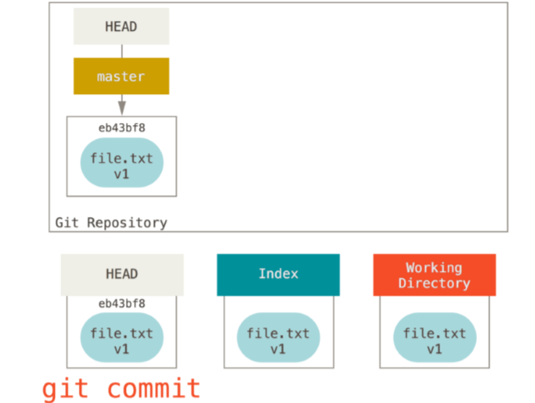
GIT WORKFLOW
Then we run git commit, which takes the contents of the Index and saves it as a permanent snapshot, creates a commit object which points to that snapshot, and updates master to point to that commit.

Slide 14
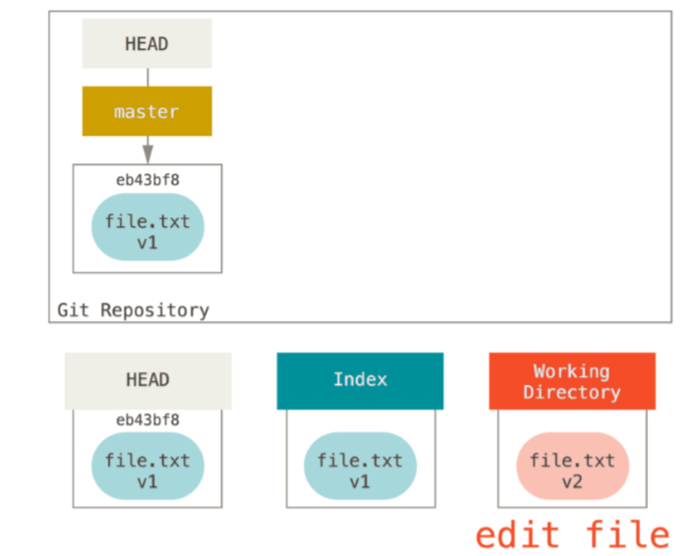
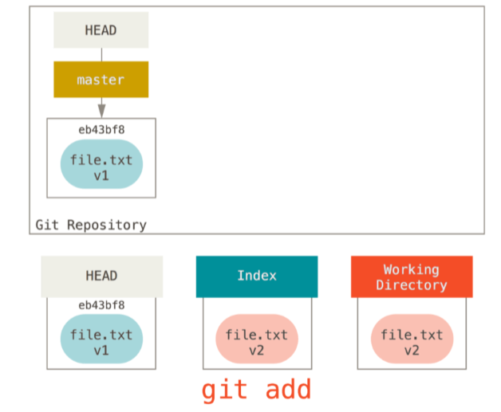
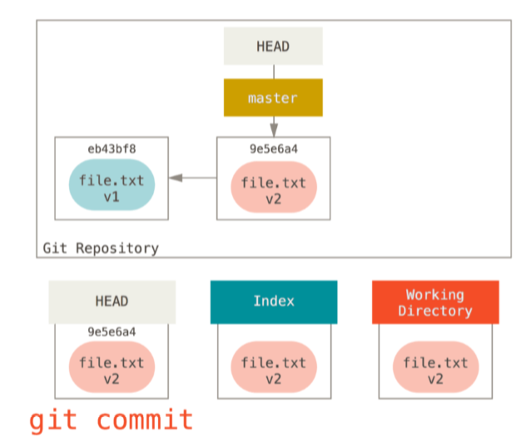
Git Workflow

Slide 15
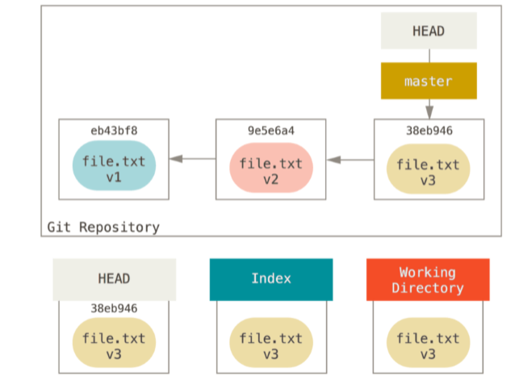
Git Workflow
For the purposes of these examples, let’s say that we’ve modified file.txt again and committed it a third time. So now our history looks like this:

Slide 16
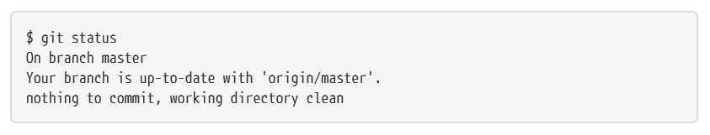
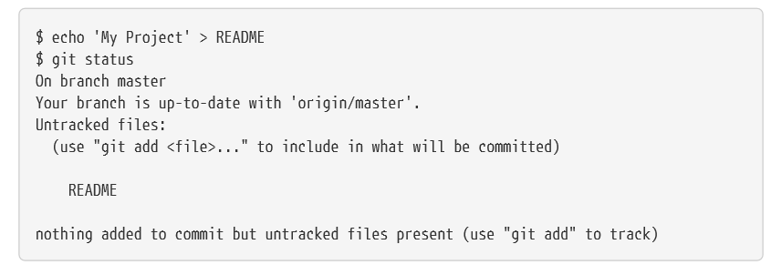
Checking the Status of Your Files
This means you have a clean working directory — in other words, none of your tracked files are modified. Git also doesn’t see any untracked files, or they would be listed here.
Finally, the command tells you which branch you’re on and informs you that it has not diverged from the same branch on the server.

Slide 17
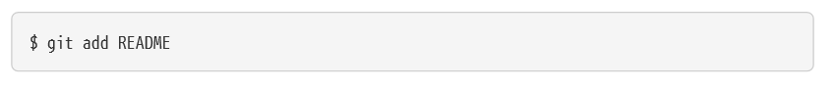
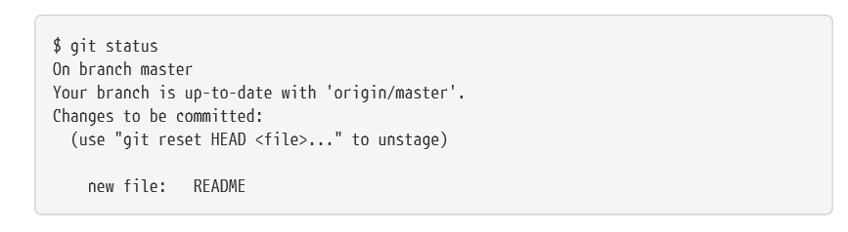
Checking the Status of Your Files

Slide 18
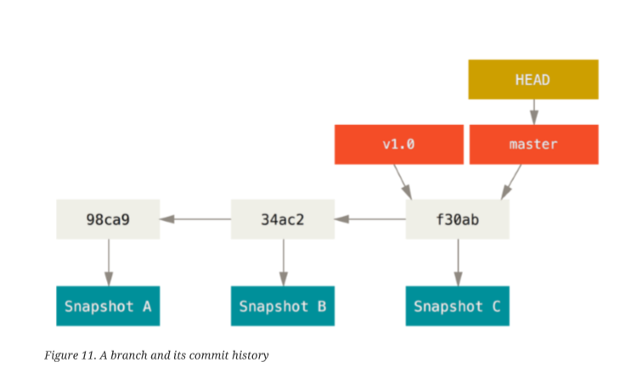
Git Branching
A branch in Git is simply a lightweight movable pointer to one of the commits.
The default branch name in Git is master.
As you start making commits, you’re given a master branch that points to the last commit you made.
Every time you commit, the master branch pointer moves forward automatically.
The “master” branch in Git is not a special branch. It is exactly like any other branch. The only reason nearly every repository has one is that the git init command creates it by default and most people don’t bother to change it
Because a branch in Git is actually a simple file that contains the 40 character SHA-1 checksum of the commit it points to, branches are cheap to create and destroy. Creating a new branch is as quick and simple as writing 41 bytes to a file (40 characters and a newline).

Slide 19
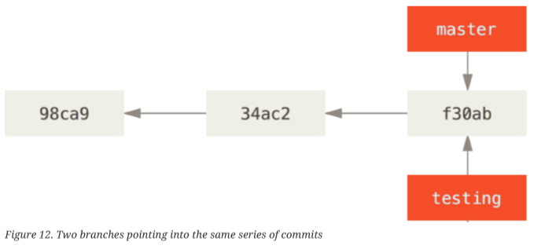
Git Branching
Creating a New Branch
What happens when you create a new branch? Well, doing so creates a new pointer for you to move around.
Let’s say you want to create a new branch called testing. You do this with the git branch command:
$ git branch testing
This creates a new pointer to the same commit you’re currently on.

Slide 20
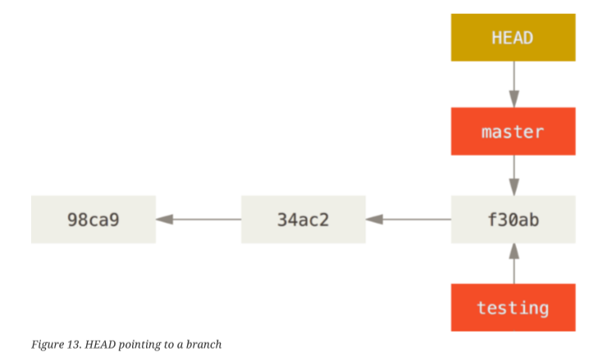
Git Branching
How does Git know what branch you’re currently on?
It keeps a special pointer called HEAD. This is a pointer to the local branch you’re currently on. In this case, you're still on master. The git branch command only created a new branch — it didn’t switch to that branch.

Slide 21
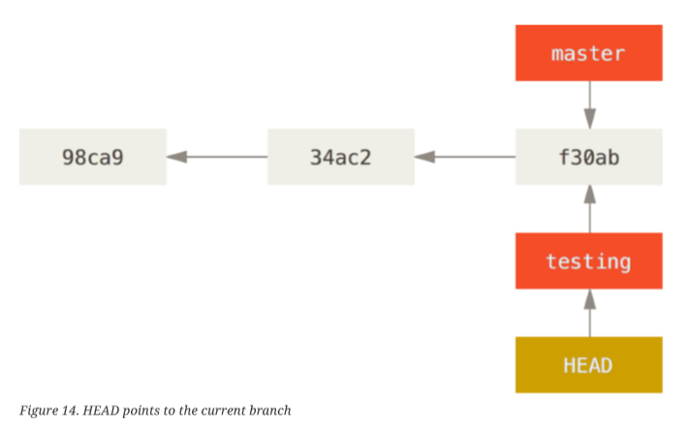
Git Branching
You can easily see this by running a simple git log command that shows you where the branch pointers are pointing. This option is called --decorate.
$ git log --oneline --decorate
f30ab (HEAD -> master, testing) add feature #32 - ability to add new formats to the central interface
34ac2 Fixed bug #1328 - stack overflow under certain conditions
98ca9 The initial commit of my project
You can see the “master” and “testing” branches that are right there next to the f30ab commit.
Switching Branches
To switch to an existing branch, you run the git checkout command. Let’s switch to the new testing branch:
$ git checkout testing (This moves HEAD to point to the testing branch.)

Slide 22
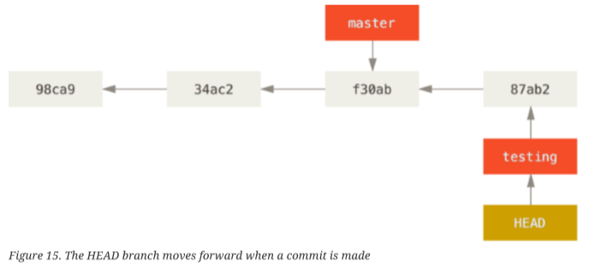
Git Branching
$ vim test.rb
$ git commit -a -m 'made a change'
This is interesting, because now your testing branch has moved forward, but your master branch still points to the commit you were on when you ran git checkout to switch branches.
Let’s switch back to the master branch:
$ git checkout master

Slide 23
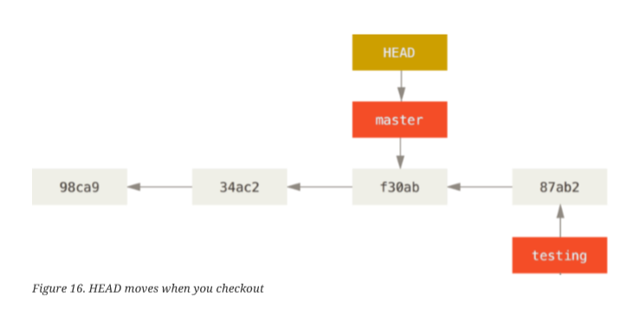
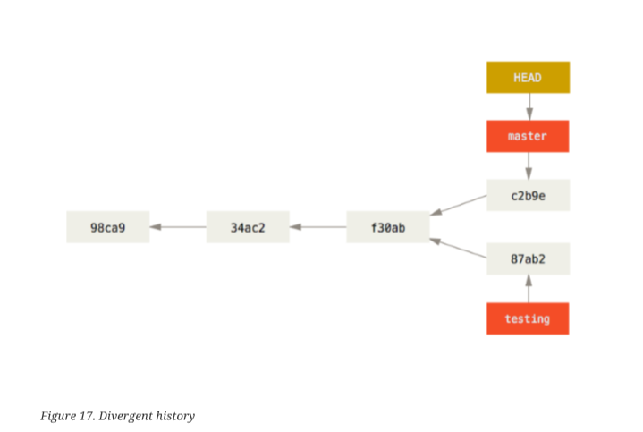
Git Branching
Let’s make a few changes and commit again:
$ vim test.rb
$ git commit -a -m 'made other changes'

Slide 24
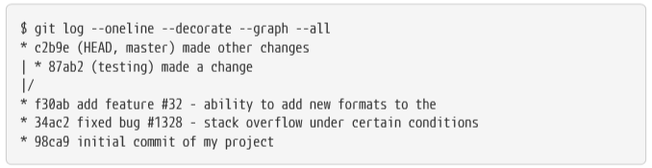
Git Branching
If you run git log --oneline --decorate --graph --all it will print out the history of your commits, showing where your branch pointers are and how your history has diverged.

Slide 25
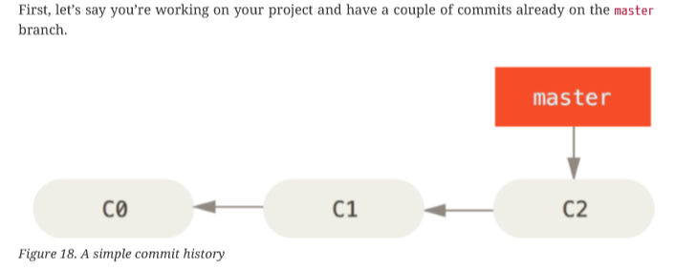
Git Branching and Merging
Let’s go through a simple example of branching and merging with a workflow that you might use in the real world. You’ll follow these steps:
1. Do some work on a website.
2. Create a branch for a new story you’re working on.
3. Do some work in that branch.
At this stage, you’ll receive a call that another issue is critical and you need a hotfix. You’ll do the following:
1. Switch to your production branch.
2. Create a branch to add the hotfix.
3. After it’s tested, merge the hotfix branch, and push to production.
4. Switch back to your original story and continue working.

Slide 26
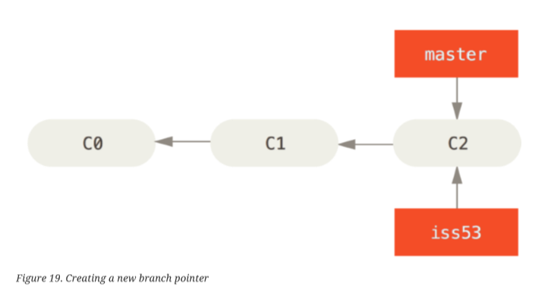
Git Branching and Merging
You’ve decided that you’re going to work on issue #53 in whatever issue-tracking system your company uses.
To create a new branch and switch to it at the same time, you can run the git checkout command with the -b switch:
$ git checkout -b iss53
Switched to a new branch "iss53"
This is shorthand for:
$ git branch iss53
$ git checkout iss53

Slide 27
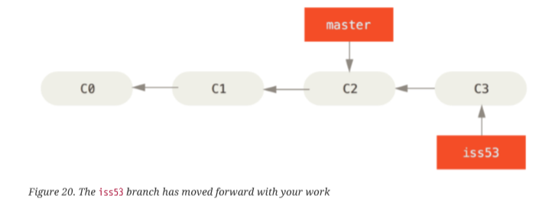
Git Branching and Merging
You work on your website and do some commits. Doing so moves the iss53 branch forward, because you have it checked out (that is, your HEAD is pointing to it):
$ vim index.html
$ git commit -a -m 'added a new footer [issue 53]'

Slide 28
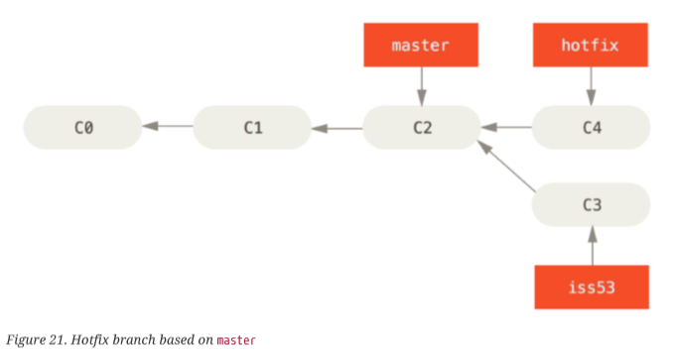
Git Branching and Merging
Now you get the call that there is an issue with the website, and you need to fix it immediately. With Git, you don’t have to deploy your fix along with the iss53 changes you’ve made, and you don’t have to put a lot of effort into reverting those changes before you can work on applying your fix to what is in production. All you have to do is switch back to your master branch.
However, before you do that, note that if your working directory or staging area has uncommitted changes that conflict with the branch you’re checking out, Git won’t let you switch branches. It’s best to have a clean working state when you switch branches.
$ git checkout master
Switched to branch 'master‘
Let’s create a hotfix branch on which to work until it’s completed:
$ git checkout -b hotfix
Switched to a new branch 'hotfix'
$ vim index.html
$ git commit -a -m 'fixed the broken email address'
[hotfix 1fb7853] fixed the broken email address
1 file changed, 2 insertions(+)

Slide 29
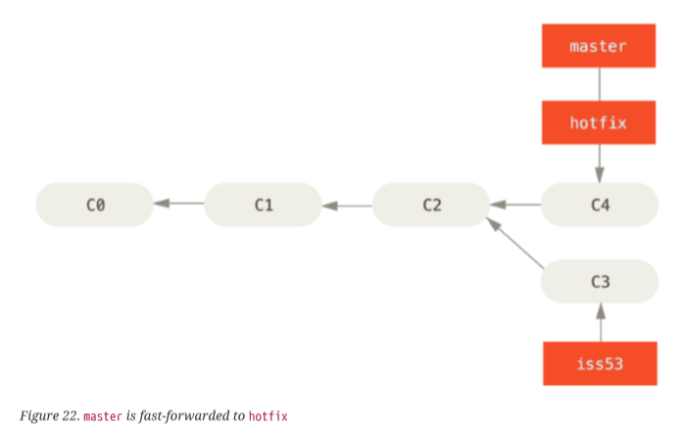
Git Branching and Merging
You can run your tests, make sure the hotfix is what you want, and finally merge the hotfix branch back into your master branch to deploy to production. You do this with the git merge command:
$ git checkout master
$ git merge hotfix
Updating f42c576..3a0874c
Fast-forward
index.html | 2 ++
1 file changed, 2 insertions(+)
You’ll notice the phrase “fast-forward” in that merge. Because the commit C4 pointed to by the branch hotfix you merged in was directly ahead of the commit C2 you’re on, Git simply moves the pointer forward. To phrase that another way,
when you try to merge one commit with a commit that can be reached by following the first commit’s history, Git simplifies things by moving the pointer forward because there is no divergent work to merge together — this is called a “fastforward.”
Your change is now in the snapshot of the commit pointed to by the master branch, and you can deploy the fix.

Slide 30
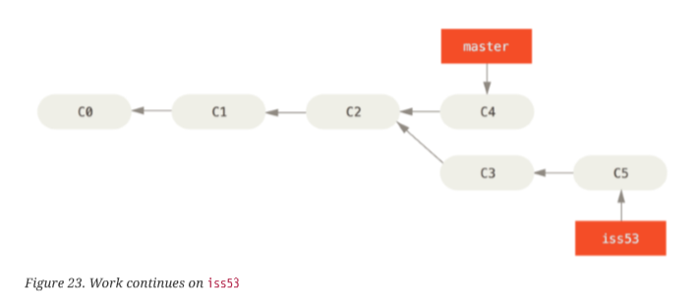
Git Branching and Merging
After your super-important fix is deployed, you’re ready to switch back to the work you were doing before you were interrupted. However, first you’ll delete the hotfix branch, because you no longer need it — the master branch points at the same place. You can delete it with the -d option to git branch:
$ git branch -d hotfix
Deleted branch hotfix (3a0874c).
Now you can switch back to your work-in-progress branch on issue #53 and continue working on it.
$ git checkout iss53
Switched to branch "iss53"
$ vim index.html
$ git commit -a -m 'finished the new footer [issue 53]'
[iss53 ad82d7a] finished the new footer [issue 53]
1 file changed, 1 insertion(+)

Slide 31
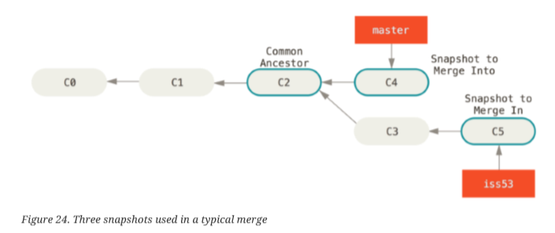
Git Branching and Merging
Suppose you’ve decided that your issue #53 work is complete and ready to be merged into your master branch. In order to do that, you’ll merge your iss53 branch into master, much like you merged your hotfix branch earlier. All you have to do is check out the branch you wish to merge into and then run the git merge command:
$ git checkout master
Switched to branch 'master'
$ git merge iss53 Merge made by the 'recursive' strategy.
index.html | 1 +
1 file changed, 1 insertion(+)

Slide 32
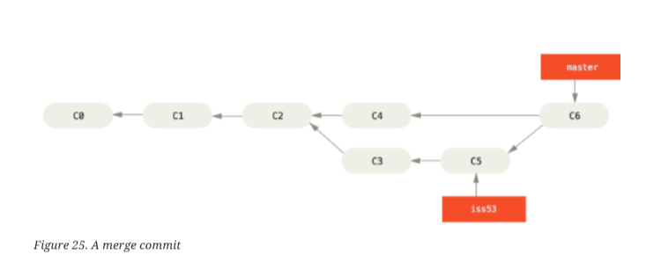
Git Branching and Merging
Instead of just moving the branch pointer forward, Git creates a new snapshot that results from this three-way merge and automatically creates a new commit that points to it. This is referred to as a merge commit, and is special in that it has more than one parent.
$ git branch -d iss53

Slide 33
Branch Management
The git branch command does more than just create and delete branches. If you run it with no arguments, you get a simple listing of your current branches:
$ git branch
iss53 *
master
Testing
To see the last commit on each branch, you can run git branch -v:
$ git branch -v
iss53 93b412c fix javascript issue
master 7a98805 Merge branch 'iss53'
testing 782fd34 add scott to the author list in the readmes
$ git branch --merged
iss53
* master
$ git branch --no-merged
testing
$ git branch -d testing

Slide 34
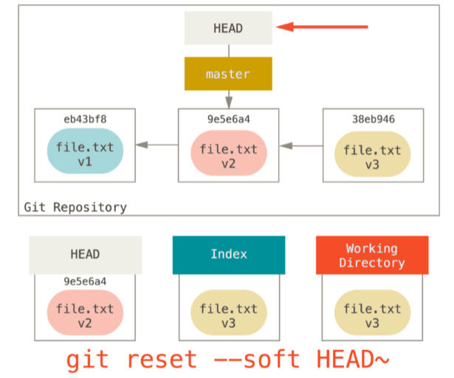
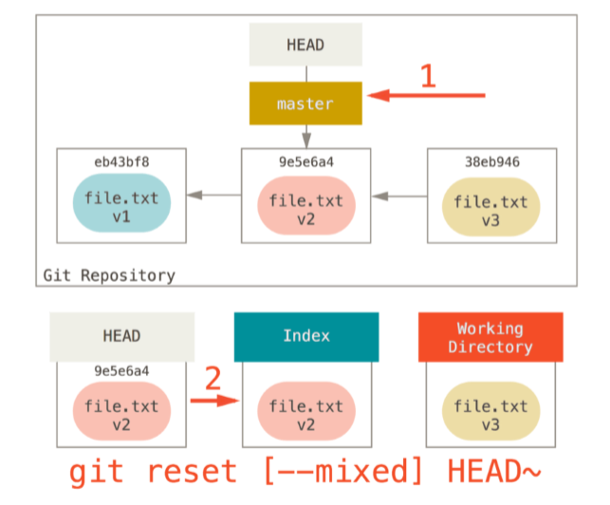
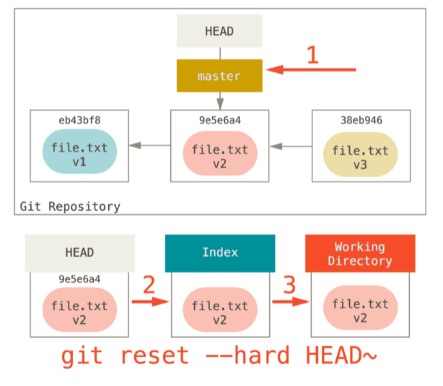
GIT RESET

Slide 35
Git Merge
When Git performs a merge, it looks for three commits:
(1) Common ancestor commit If you follow the history of two branches in a project, they always have at least one commit in common: at this point in time, both branches had the same content and then evolved differently.
(2) + (3) Endpoints of each branch The goal of an integration is to combine the current states of two branches. Therefore, their respective latest revisions are of special interest. Combining these three commits will result in the integration we're aiming for.

Slide 36
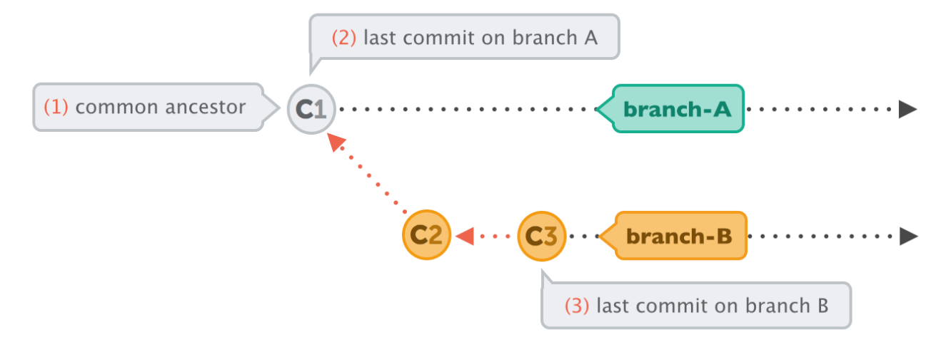
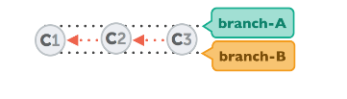
Fast-Forward Merge
In very simple cases, one of the two branches doesn't have any new commits since the branching happened - its latest commit is still the common ancestor.
In this case, performing the integration is dead simple: Git can just add all the commits of the other branch on top of the common ancestor commit. In Git, this simplest form of integration is called a "fast-forward" merge. Both branches then share the exact same history.

Slide 37
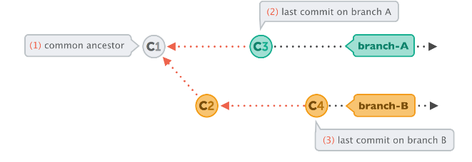
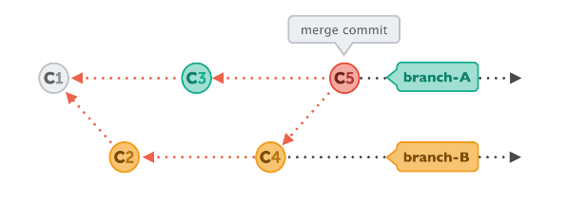
Merge Commit
In a lot of cases, however, both branches moved forward individually.
To make an integration, Git will have to create a new commit that contains the differences between them - the merge commit.

Slide 38
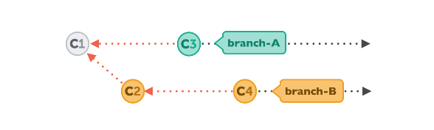
Git Rebase
Let's walk through a rebase operation step by step. The scenario is the same as in the previous examples: we want to integrate the changes from branch-B into branch-A, but now by using rebase
git rebase branch-A // syncs the history with branch-A
git checkout branch-A // change the current branch to branch-A
git merge branch-B // merge/take the changes from branch-B to branch-A

Slide 39
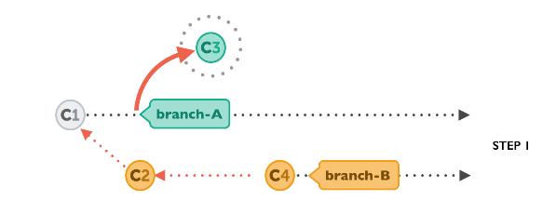
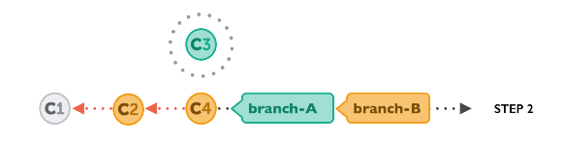
Git Rebase
First, Git will "undo" all commits on branch-A that happened after the lines began to branch out (after the common ancestor commit). However, of course, it won't discard them: instead you can think of those commits as being "saved away temporarily".
Next, it applies the commits from branch-B that we want to integrate. At this point, both branches look exactly the same.

Slide 40
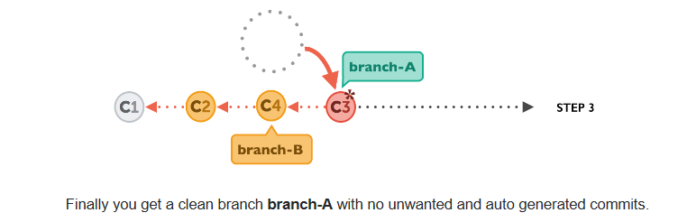
Git Rebase
In the final step, the new commits on branch-A are now reapplied - but on a new position, on top of the integrated commits from branch-B (they are re-based). The result looks like development had happened in a straight line. Instead of a merge commit that contains all the combined changes, the original commit structure was preserved.

Slide 41
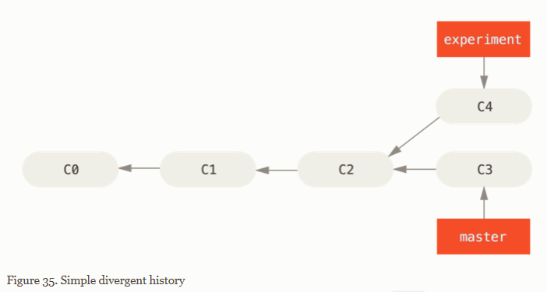
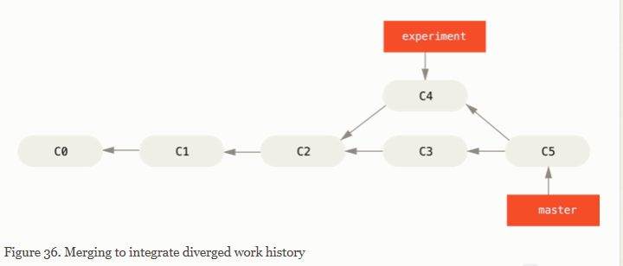
Git Branching - Rebasing

Slide 42
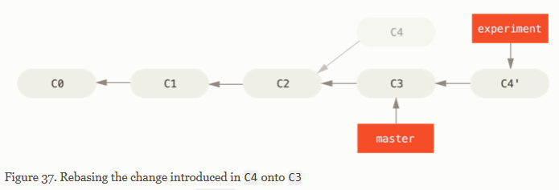
Git Branching - Rebasing
However, there is another way: you can take the patch of the change that was introduced in C4 and reapply it on top of C3. In Git, this is called rebasing. With the rebase command, you can take all the changes that were committed on one branch and replay them on a different branch.
For this example, you would check out the experiment branch, and then rebase it onto the master branch as follows:
$ git checkout experiment
$ git rebase master
First, rewinding head to replay your work on top of it...
Applying: added staged command

Slide 43
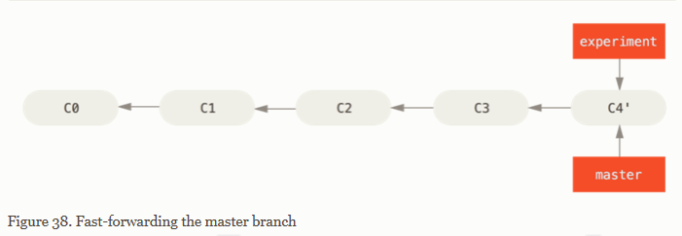
Git Branching - Rebasing
At this point, you can go back to the master branch and do a fast-forward merge.
$ git checkout master
$ git merge experiment

Slide 44
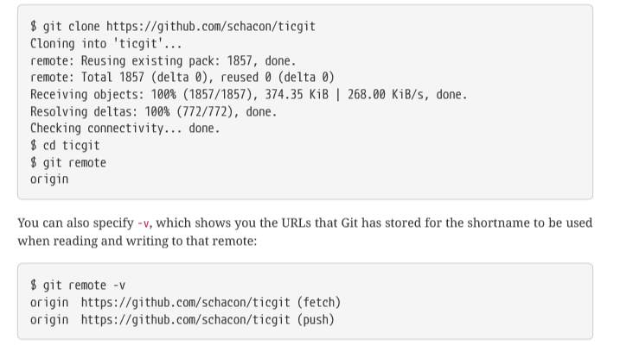
Working with Remotes
To see which remote servers you have configured, you can run the git remote command. It lists the short names of each remote handle you’ve specified. If you’ve cloned your repository, you should at least see origin — that is the default name Git gives to the server you cloned from:

Slide 45

Multiple Remote

Slide 46

Adding Remote Repo
git remote add <shortname> <url>:

Slide 47
Fetch and Pull from Remote
git fetch <remote>
git fetch origin fetches any new work that has been pushed to that server since you cloned (or last fetched from) it.
git fetch command only downloads the data to your local repository — it doesn’t automatically merge it with any of your work or modify what you’re currently working on. You have to merge it manually into your work when you’re ready.
git pull generally fetches data from the server you originally cloned from and automatically tries to merge it into the code you’re currently working on.
git push <remote> <branch>
git push origin master

Slide 48

Inspecting a Remote
git remote show <remote> command

Slide 49

Inspecting a Remote

Slide 50


Renaming and Removing Remotes
You can run git remote rename to change a remote’s shortname. For instance, if you want to rename pb to paul, you can do so with git remote rename:

Slide 53


Slide 54
$7 BILLION | 110,000 EMPLOYEES | 31 COUNTRIES

